Slide 1
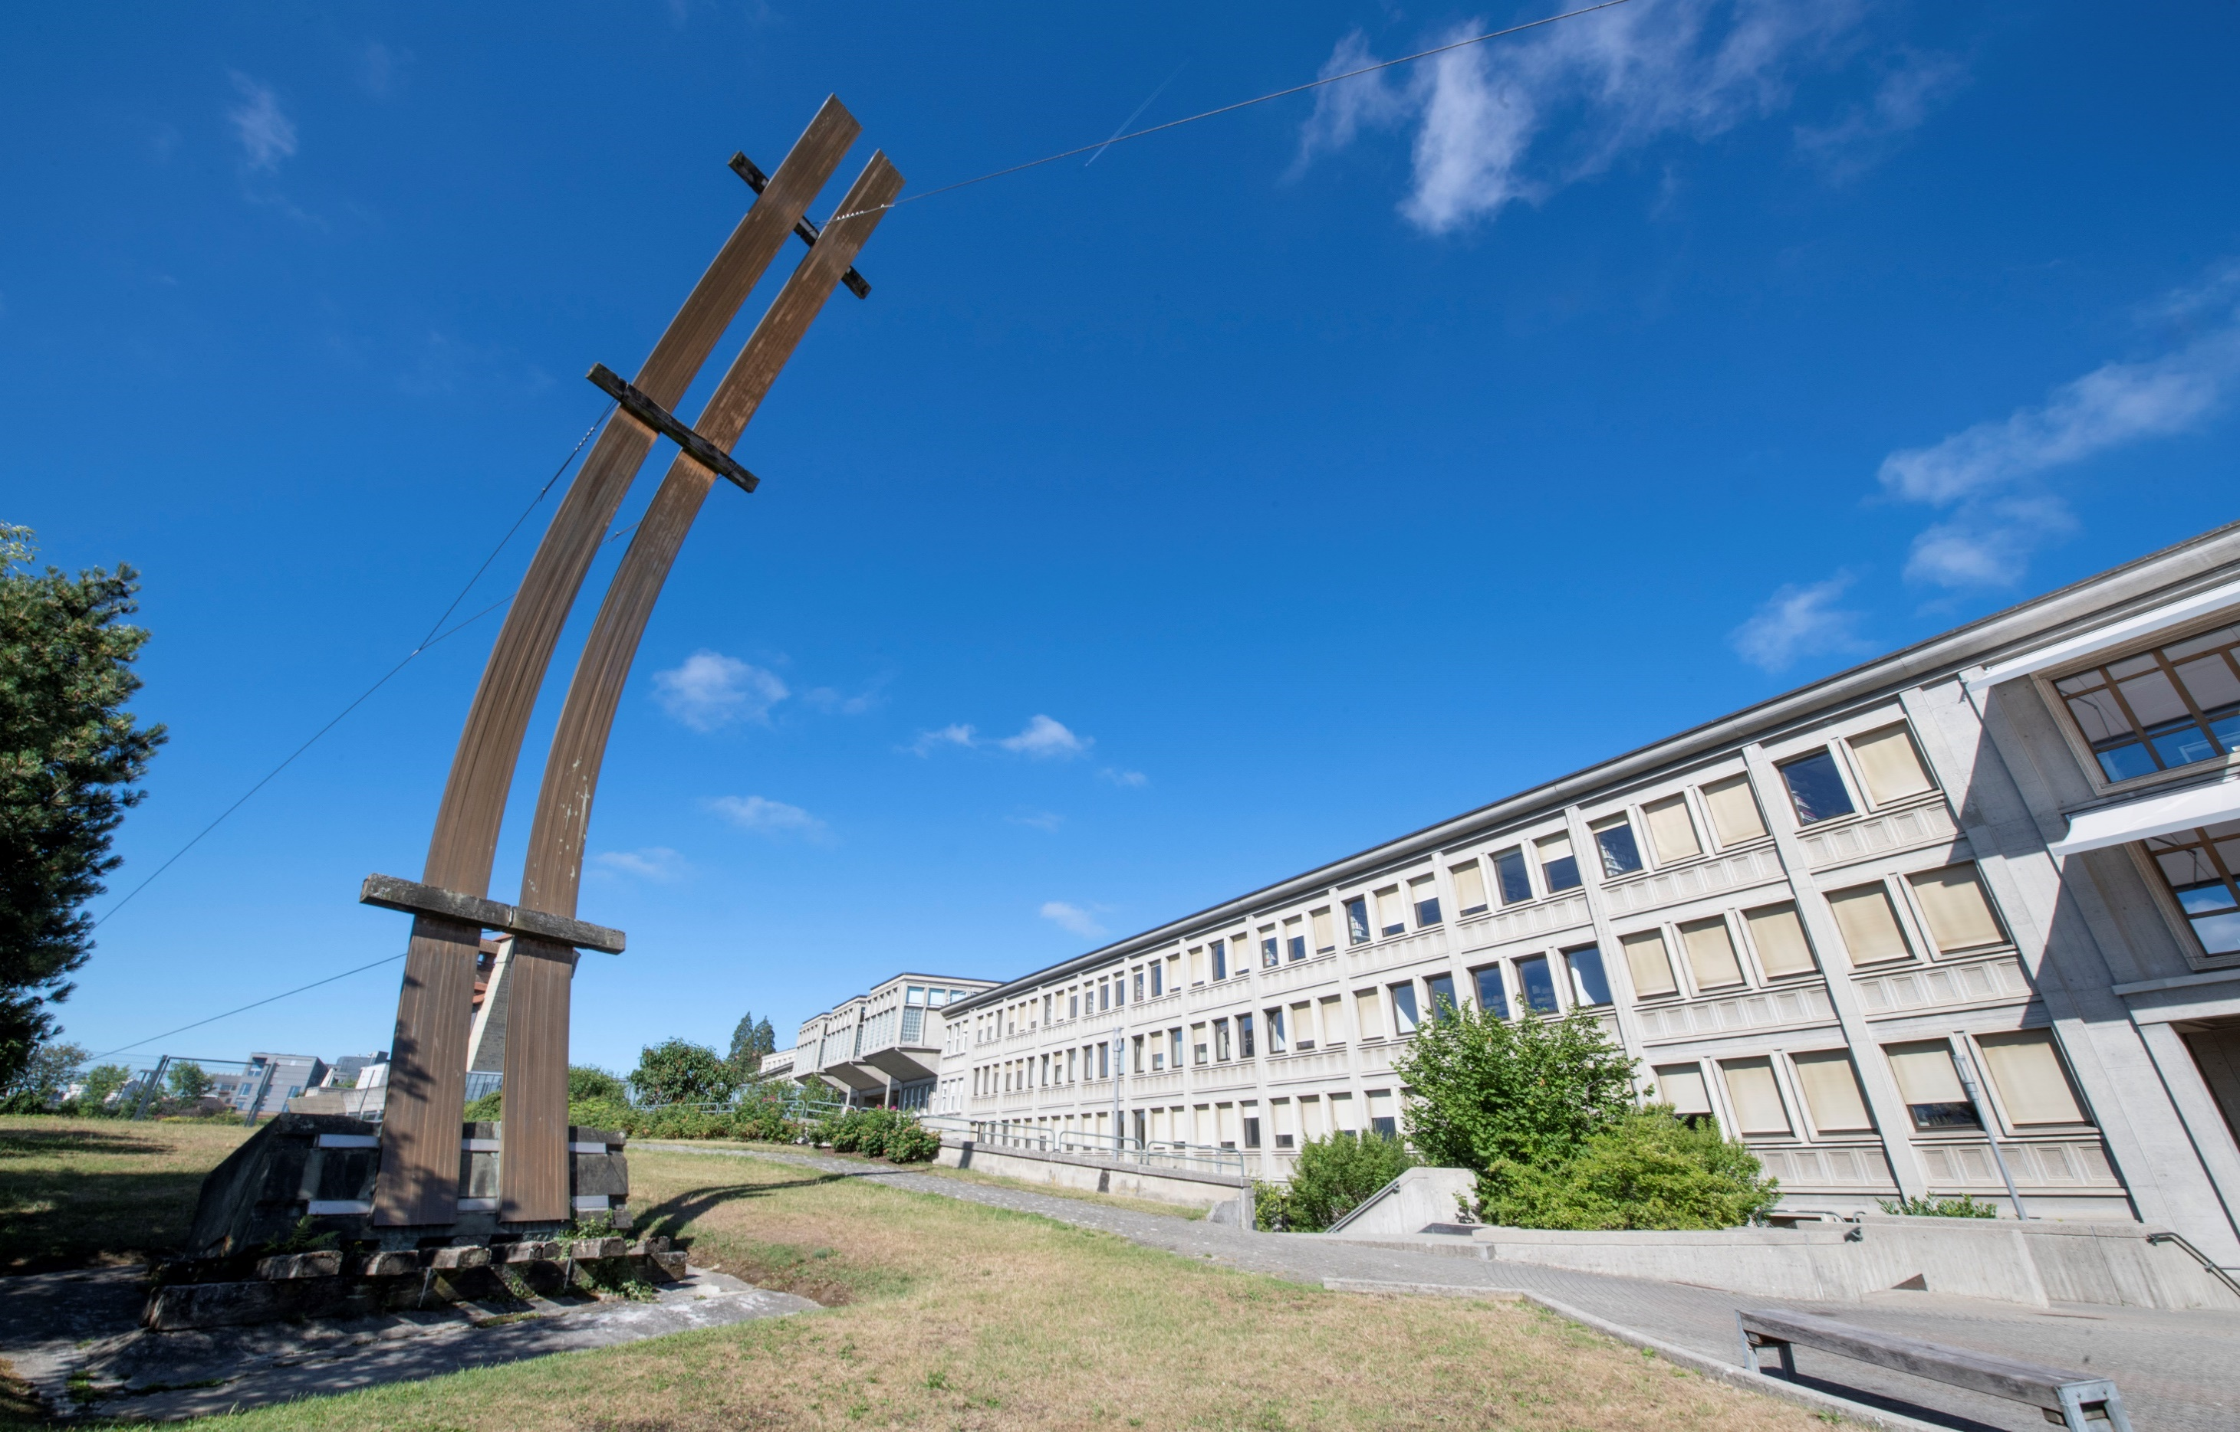
How to Get Funding during your PhD
  Research Promotion Service
  14 February 2023

Slide 2

Notes:
Um Eure Projekte zum Fliegen zu bringen, dafür sind wir da.
Einige von Euch brauchen ev. Finanzierung für PhD-Projekt, andere möchten einen Teil des Doktorats im Ausland verbringen, andere brauchen Unterstützung für die Publikation ihrer Doktorarbeit. Wir unterstützen Euch dabei.

Slide 3
Opportunities for you
Doc.mobility
Doc.ch
Publication grants SNSF
Mobility grants in SNSF projects
OA fund Unifr

Slide 4
SPR Services
Funding Opportunities:
Internal, national, EU, worldwide
Advice; finding funding;
info on open and announced calls
EU Projects
Info and advice for EU projects; admin; budget; proposal preview etc.
Open Science
Info; DMP support;
OA publications
Proposal Support
Admin; budget; prescreening; ethics;
Interview training, etc.
ORCID
Info and Trainings

Slide 5
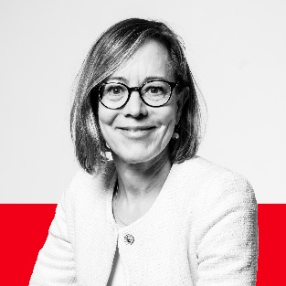
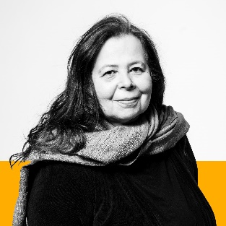
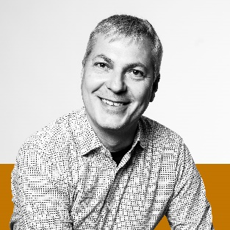
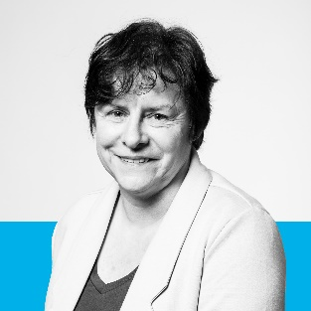
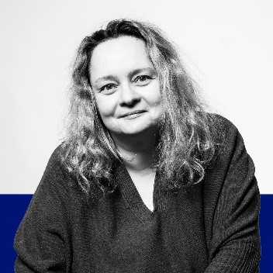
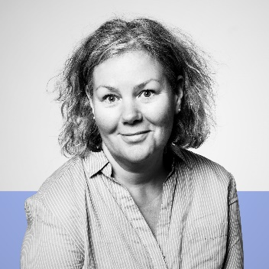
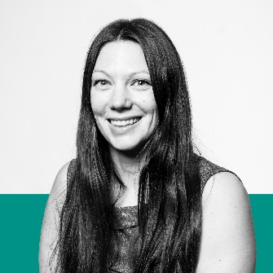
UNIFR Research Promotion Service
Dr. Katja Wirth, Head
Strategy
Transition Measures
Dr. Barbara Gorodecki
SNSF
Transition Measures
Dr. Matthias Held
SNSF
EU Programs
Transition Measures
Open Science
Doris Kolly
EU Programs / Euresearch
Transition Measures
Companies
Tatjana Matic
General questions
Open access publication of PhD thesis
Anne Progin
Fonds du centenaire
Pool de recherche
Doc.Mobility
Dr. Juliette Vuille
SNSF
Humanities
Communication
New collaborator
Ranking
ORCID

Slide 6
Others at Unifr who may support you
Mobility programs and around 150 bilateral agreements managed by the International Relations Office
CSWM

Slide 7




research@unifr.ch
Researcher Portal @unifr
Don’t hesitate to contact us!
We help UniFR research flourish!

